Slide 1
Lane detection
Line-CNN
Report
Yunzhi Nie
180940

Slide 2
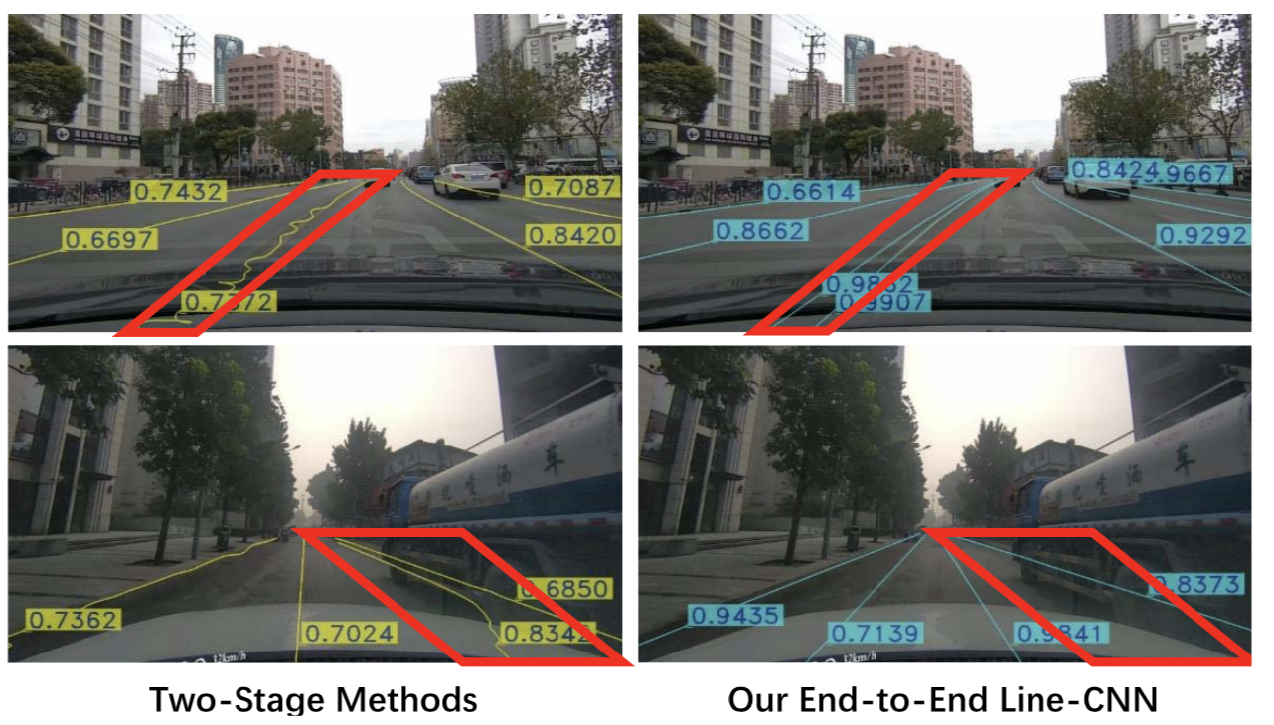
Introduction
Traditional method：
“segment detection” + segment cluster
Gaussian + RANSAC
STOA:
FCN+DBSCAN
VPGnet
Multitask CNN + RNN
LaneNet
SCNN
Two-stage methods are isolated and the global information of lines cannot be preserved to afford the distinguishability of different lines in the clustering stage, especially in the presence of shadows or heavy occlusions.

Slide 3
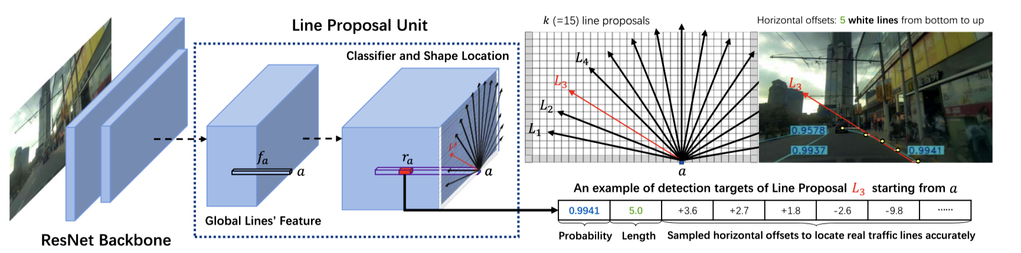
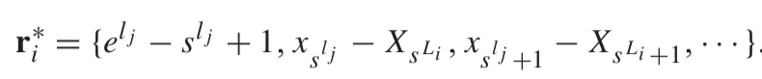
Pipeline of Line-CNN：
Line-CNN

Slide 4
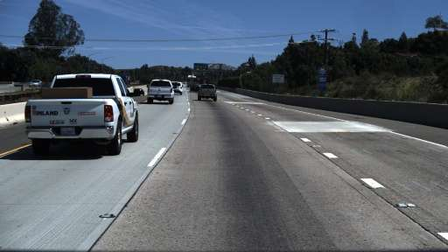
Line-CNN
Model:
(N,1024,18,1)
(N,450,18,1)
Resnet122
(N,1014,1,30)
(N,1125,1,30)
16 x downsampling
(N,1024,18,1)
(N,450,18,1)

Slide 5
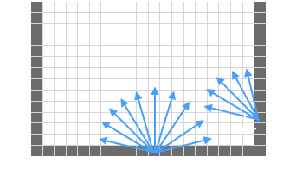
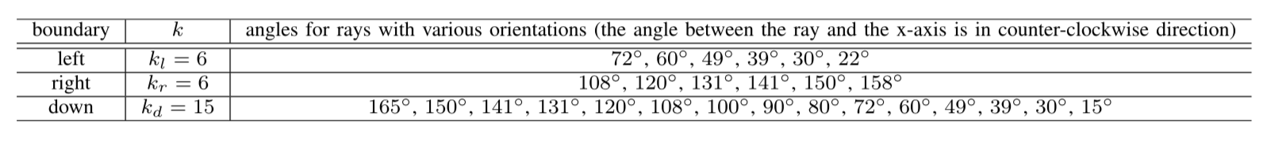
Practical settings for line proposal rays on three boundaries:
Line-CNN
By adopting k-means clustering

Slide 6
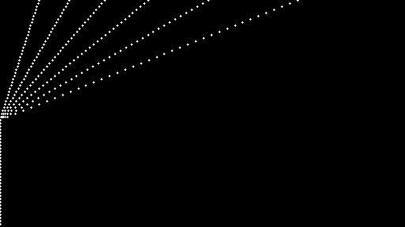
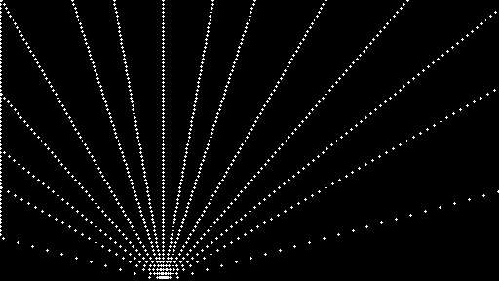
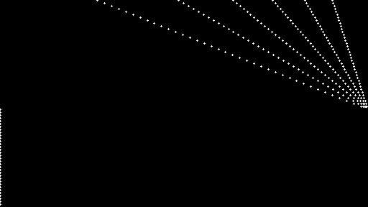
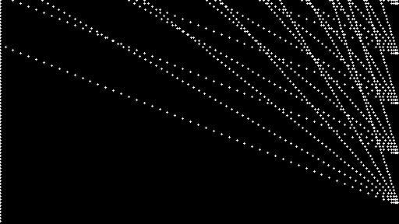
Line-CNN
Proposel:

Slide 7
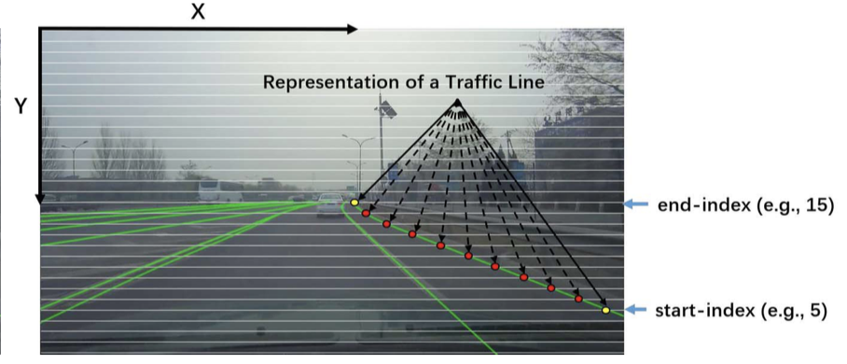
Example of the representation of one line:
Line-CNN
A traffic line is represented by a set of points which are the intersections of the horizontal slicing lines and itself.

Slide 8
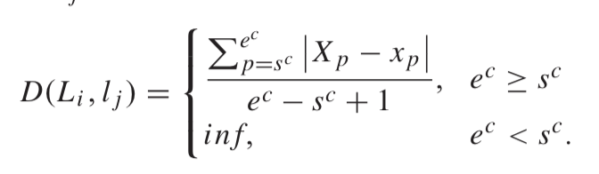
Region-Region Metric to Line-Line Metric:
Line-CNN
e^{c}
s^{c}
s^{c}
Line-Line Metric Applied to:
Assign P/N label to a line proposal
K-means
NMS
…
e^{c}

Slide 9
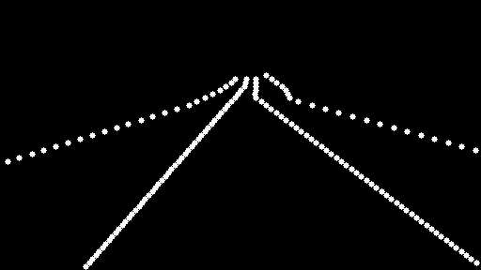
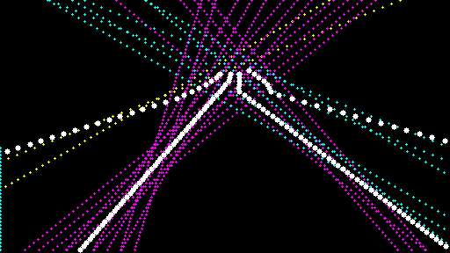
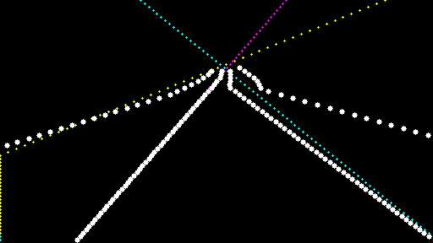
Line-CNN
threshold_pos < 30
threshold_pos < 10

Slide 10
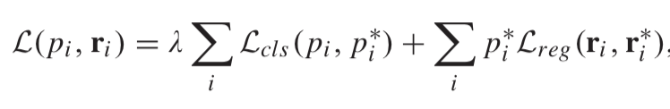
Loss Function:
Line-CNN
For training Line-CNN, we assign a binary class label (of being a real traffic line or not) to each line proposal (straight ray). We assign a positive label to a line proposal L_{i} if two requirements are satisfied: (i) it has a smallest distance D(L_{i} , l _{j} ) = d to a ground-truth traffic line l _{j} , and (ii) d < t_pos, where t_pos is a hyper-parameter to control the threshold of positive labels.

Slide 11
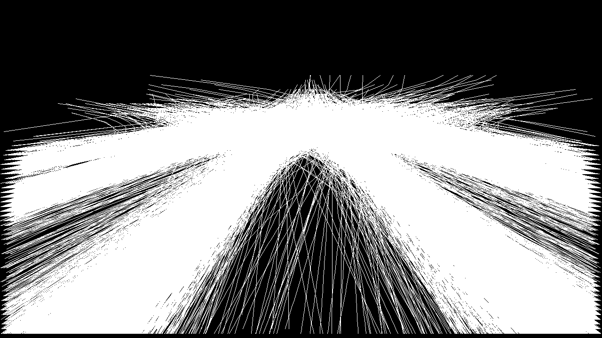
Line-CNN
Visualize all traffic lines from Tusimple’s dataset

Slide 12
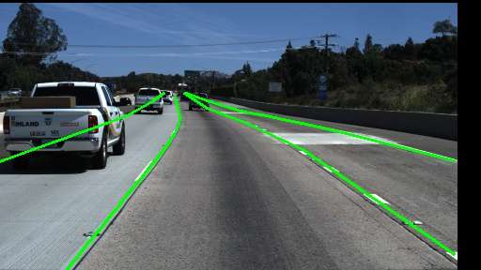
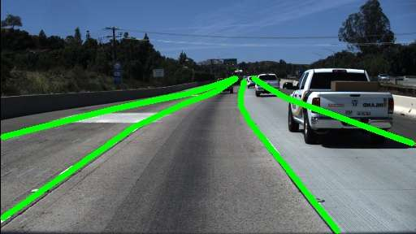
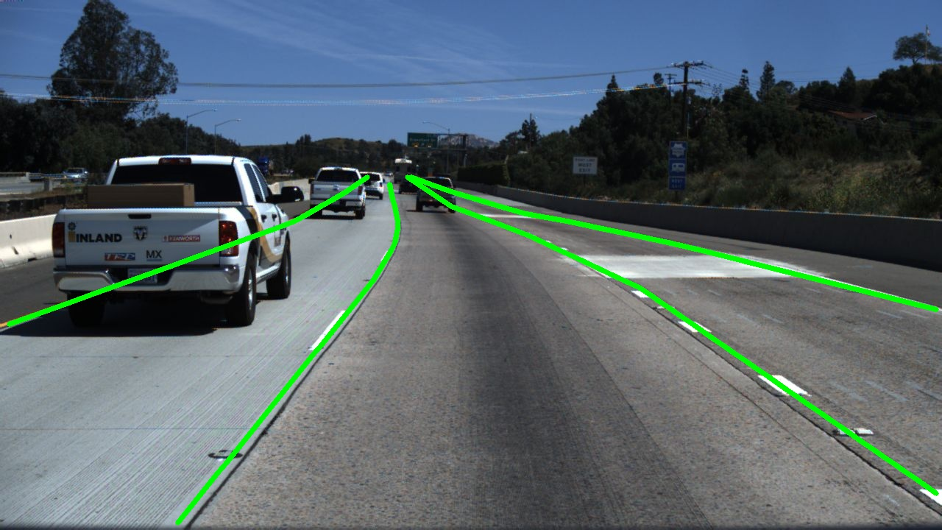
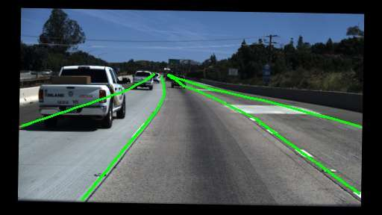
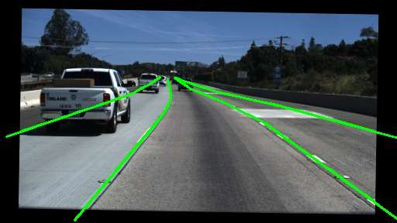
My implementation
Image Augmentation with label:

Slide 13
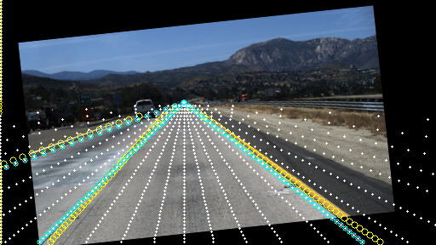
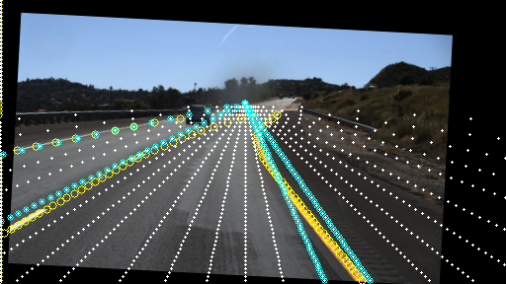
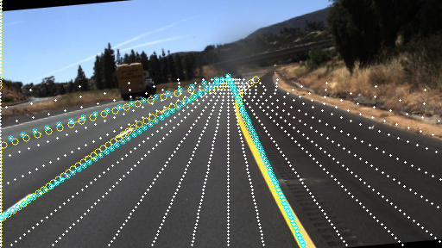
Corresponding anchor with Data Augmentation

Slide 14
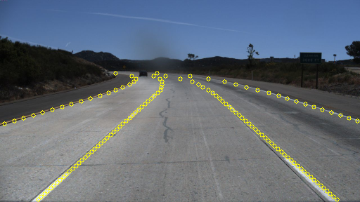
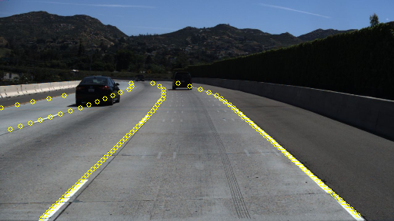
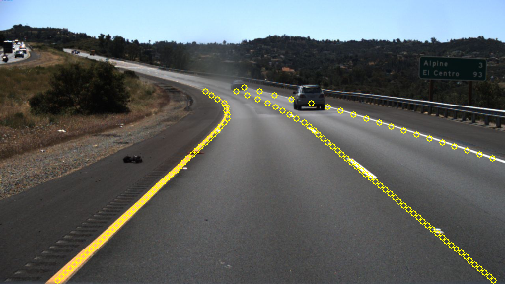
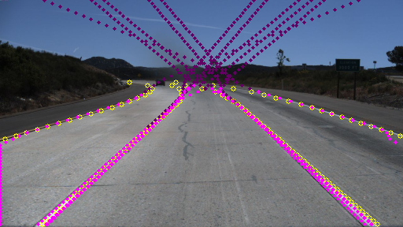
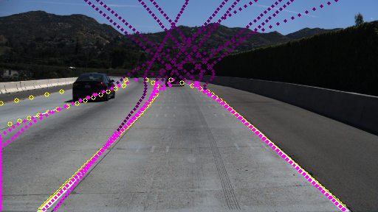
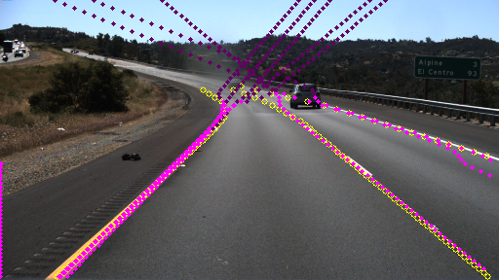
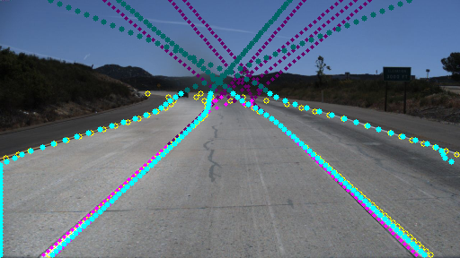
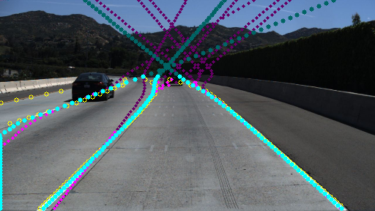
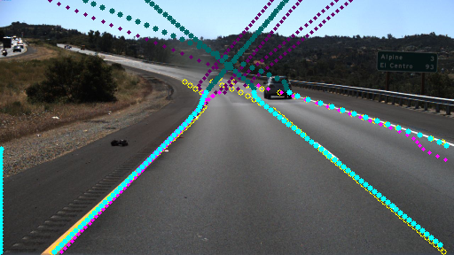
Line-CNN
Ground Truth
Predicted
NMS

Slide 15
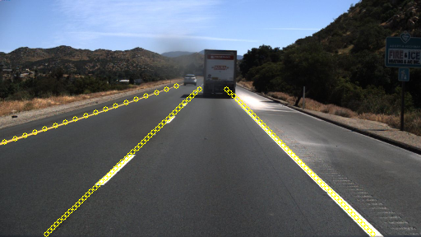
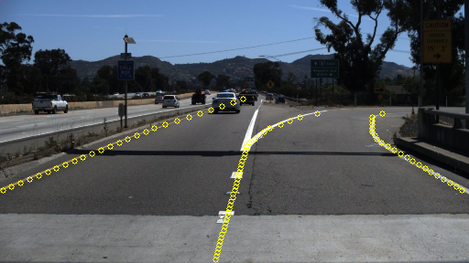
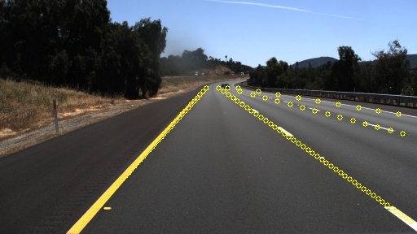
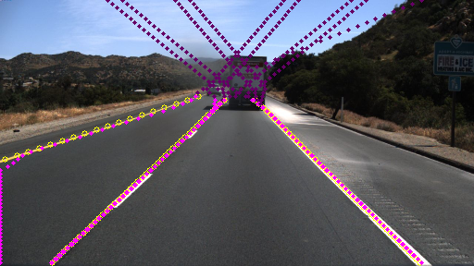
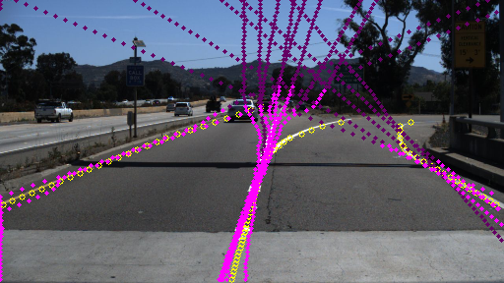
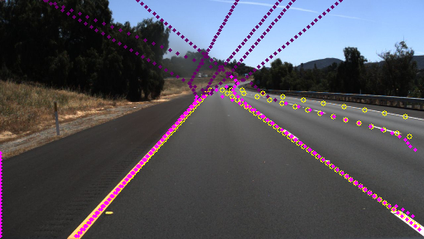
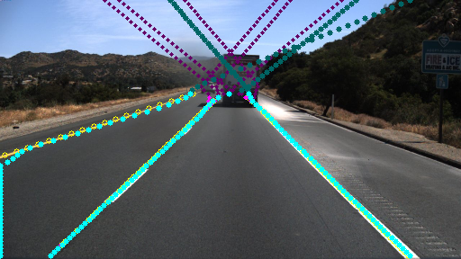
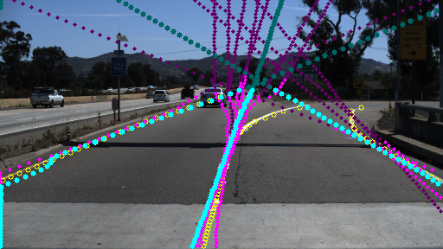
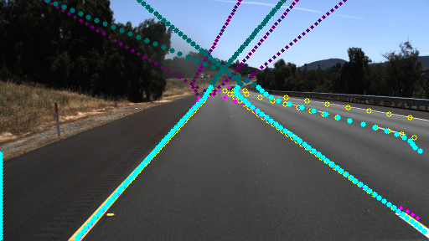
Line-CNN
Ground Truth
Predicted
NMS

Slide 16
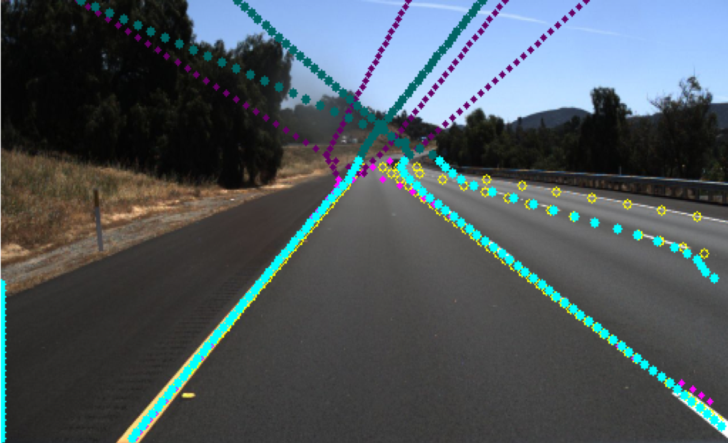
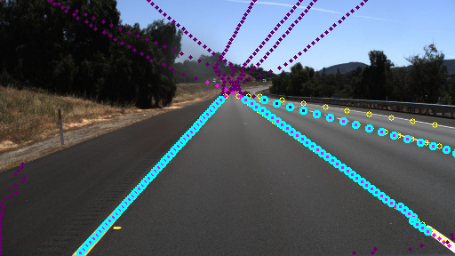
Line-CNN
Improving the regression result

Slide 17
Line-CNN
Result on TuSimple dataset
Solution From | Accuracy | FP | FN
L-CNN(authors) | 0.9687 | 0.442 | 0.1970
SCNN(XingangPan) | 0.9653 | 0.0617 | 0.0180
L-CNN(ours) | 0.9342 | 0.0714 | 0.0581

Slide 18
Correct line’s start point and analysis FN’s reason
Improving our approach’s acc

Slide 19
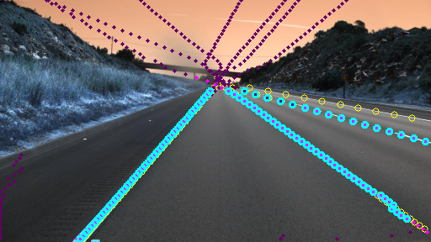
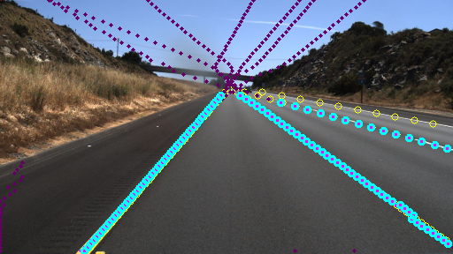
Line-CNN

Slide 20
Line-CNN
Solution From | Accuracy | FP | FN
L-CNN(authors) | 0.9687 | 0.0442 | 0.0198
SCNN(XingangPan) | 0.9653 | 0.0617 | 0.0180
L-CNN(1) | 0.9342 | 0.0714 | 0.0581
L-CNN(2) | 0.9570 | 0.0366 | 0.0293

Slide 21
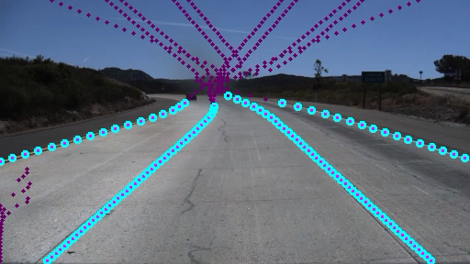
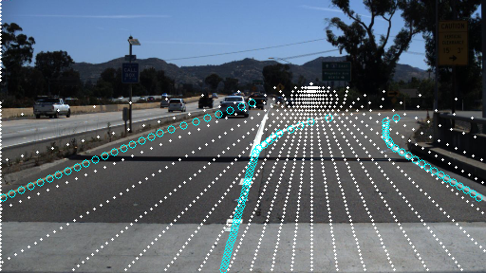
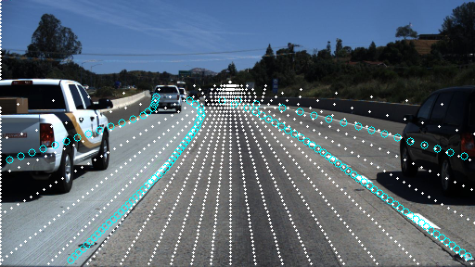

Lane Detection based on L-CNN
Model:
(N,1024,18,1)
(N,450,18,1)
Anchor NMS Result
Resnet122
(N,1014,1,30)
(N,1125,1,30)
(N,1024,1,1)
(N,1875,1,1)
16 x down sampling
(N,1024,18,1)
(N,450,18,1)
Combine with VPP

